Slide 1
MATH 166: Introductory Probability and Statistics
Dr. Eric Nimako Aidoo
en.aidoo@yahoo.com
0202901980

Slide 2
3- 1
Numerical Summary

Slide 3
Raw data
The data represent the highest temperature recorded by a remote sensor in 50 countries.
112, 100, 127, 120, 134, 118, 105, 110, 109, 112,
110, 118, 117, 116, 118, 112, 114, 114, 105, 109,
107, 112, 114, 115, 118, 117, 118, 122, 106, 110,
116, 108, 110, 121, 113, 120, 119, 111, 104, 111,
120, 113, 120, 117, 105, 110, 118, 112, 114, 114.
What can you say about this data?
Notes:
2

Slide 4
Measures of Central Tendency

Slide 5
Measures of Central Tendency
Measures of Central Tendency: These measures, often referred to as averages, describe the centre of any given data set. They are useful measure to summarize a given data set.
Measures of Central Tendency
The Arithmetic Mean
The Median
The Mode

Slide 6
The Arithmetic Mean
The Arithmetic Mean is the most widely used measure of location and shows the central value of the data.
It is calculated by summing the values and dividing by the number of values.

Slide 7
Population Mean
The Arithmetic Mean
For ungrouped data, the Population Mean is the sum of all the population values divided by the total number of population values:
where
µ is the population mean
N is the total number of observations.
X is a particular value.
Σ indicates the operation of adding.

Slide 8
Example 1
The Arithmetic Mean: Example
Aidoo’s family owns four cars. The following is the current mileage on each of the four cars.
56,000
42,000
23,000
73,000
Find the mean mileage for the cars.

Slide 9
Sample Mean
The Arithmetic Mean
For ungrouped data, the sample mean is the sum of all the sample values divided by the number of sample values:
where n is the total number of values in the sample.

Slide 10
The Arithmetic Mean: Example
The number of days travelled by five drones to record event in space last year:
14, 15, 17, 16, 15

Slide 11
The Mean of Grouped Data
The Arithmetic Mean
3- 10
The Mean of a sample of data organized in a frequency distribution is computed by the following formula:
where X and f represent the midpoint and frequency of each class respectively

Slide 12
The Arithmetic Mean for grouped data
The minimum temperature of twenty districts in Ghana recorded by drone last year December is presented in the frequency distribution table.
Compute the mean number of movies showing.
Class limit | Frequency (f) | Midpoint (x) | fx
6 – 10 | 1 | 8 | 8
11 – 15 | 2 | 13 | 26
16 – 20 | 3 | 18 | 54
21 – 25 | 5 | 23 | 115
26 – 30 | 4 | 28 | 112
31 – 35 | 3 | 33 | 99
36 – 40 | 2 | 38 | 76
 | n=20 |  | Ʃfx = 490

Slide 13
The Arithmetic Mean
Characteristics of the Arithmetic Mean
The mean is unique for any set of numerical data.
All the values are included in computing the mean.
It is applicable to quantitative data only
The mean is affected by extremely large or small data values.

Slide 14
The Median
The Median is the midpoint of the values after they have been ordered from the smallest to the largest.
There are as many values above the median as below it in the data array.
For an even set of values, the median will be the arithmetic average of the two middle numbers.

Slide 15
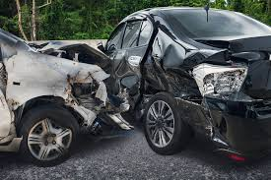
The Median: Example
3- 14
The number of traffic crashes occurred on a road segment over five year period:
21, 25, 19, 20, 22.
Calculate the median crashes
Arranging the data in ascending order gives:
19, 20, 21, 22, 25.
Thus the median crashes is 21.

Slide 16

The Median: Example
The number of minutes travelled by four missiles to hit target at the same location are:
76, 73, 80, 75.
Arranging the data in ascending order gives:
73, 75, 76, 80
Thus, the median is 75.5.
The median is given by
(75+76)/2 = 75.5

Slide 17
The Median: Grouped Data
3- 16
The Median of a sample of data organized in a frequency distribution is computed by:
where L is the lower class boundary of the median class, CF is the cumulative frequency before the median class, f_{m} is the frequency of the median class,
w is the class width,
n is the total number of values in the sample.

Slide 18
Finding the Median Class
The Median
3- 17
To determine the median class for grouped data
Construct a cumulative frequency distribution.
Divide the total number of data values by 2.
Determine which class will contain this value. For example, if n=50, 50/2 = 25, then determine which class will contain the 25th value.

Slide 19
The Median: Example
Class limit | Class boundary | Frequency (f) | Cum. Freq.
6 – 10 | 5.5 – 10.5 | 1 | 1
11 – 15 | 10.5 – 15.5 | 2 | 3
16 – 20 | 15.5 – 20.5 | 3 | 6
21 – 25 | 20.5 – 25.5 | 5 | 11
26 – 30 | 25.5 – 30.5 | 4 | 15
31 – 35 | 30.5 – 35.5 | 3 | 18
36 - 40 | 35.5 – 40.5 | 2 | 20
 |  | n=20

Slide 20
The Median: Example
From the table,
L=20.5, n=20, f_{m}=5, w=5, CF=6

Slide 21
The Median
Characteristics of the Median
There is a unique median for each data set.
It is not affected by extremely large or small values and is therefore a valuable measure of location when such values occur.
It can be computed for ratio-level, interval-level, and ordinal-level data.
50% of the observations lies above the median and 50% falls below it.

Slide 22
The Mode
3- 21
The Mode is another measure of location and represents the value of the observation that appears most frequently.
Example 6: The number of minutes travelled by ten different satellites to record an event in a location are: 81, 93, 84, 75, 68, 87, 81, 75, 81, 87.
Find the mode
Because the distance of 81 occurs the most often, it is the mode.

Slide 23
The Mode: Grouped Data
3- 22
The Mode for grouped data is approximated by the midpoint of the class with the largest class frequency.
Class limit | Class boundary | Frequency (f) | Cum. Freq.
6 – 10 | 5.5 – 10.5 | 1 | 1
11 – 15 | 10.5 – 15.5 | 2 | 3
16 – 20 | 15.5 – 20.5 | 3 | 6
21 – 25 | 20.5 – 25.5 | 5 | 11
26 – 30 | 25.5 – 30.5 | 4 | 15
31 – 35 | 30.5 – 35.5 | 3 | 18
36 - 40 | 35.5 – 40.5 | 2 | 20
 |  | n=20
The mode is 23. But modal class is 21–25 and modal frequency is 5

Slide 24
The Mode
Characteristics of the Mode
Data can have more than one mode. If it has two modes, it is referred to as bimodal.
The mode is not influence by extreme values
The mode can be found for both quantitative and qualitative data.

Slide 25
The Measures of Dispersion

Slide 26
The Measures of Dispersion
Measures of Dispersion: These measures, describe the spread or variability in a data set.
Measures of dispersion include the following: range, mean deviation, variance, standard deviation and coefficient of variation.

Slide 27
The Range
3- 26
Range = Largest value – Smallest value
The following represents the minimum temperature recorded by a remote sensor for 25 countries in Europe.
Highest value: 22.1
Lowest value: -8.1
Range = Highest value – lowest value
= 22.1-(-8.1)
= 30.2

Slide 28
The Mean Deviation
3- 27
Mean Deviation The arithmetic mean of the absolute values of the deviations from the arithmetic mean.
The main features of the mean deviation are:
All values are used in the calculation.
It is not unduly influenced by large or small values.
The absolute values are difficult to manipulate.

Slide 29
The Mean Deviation: Example
3- 28
The number of minutes travelled by five missiles to hit an object at the same location are:
103, 97, 101, 106, 103
Find the mean deviation.
X = 102
The mean deviation is:

Slide 30
The Variance and Standard Deviation
3- 29
Variance: the arithmetic mean of the squared deviations from the mean.
Standard deviation: The square root of the variance.

Slide 31
The Variance and Standard Deviation
3- 30
Population Variance formula:
X is an observed values in the population
u is the arithmetic mean of the population
N is the number of observations in the population
Population Standard Deviation formula:

Slide 32
The Variance and Standard Deviation: Example
The variance and standard deviation from the
previous example are:

Slide 33
The Variance and Standard Deviation
Sample variance (s²)
Sample standard deviation (s)

Slide 34
The Variance and Standard Deviation: Example
The hourly wages earned by a sample of five students are:
$7, $5, $11, $8, $6.
Find the sample variance and standard deviation.

Slide 35
The coefficient of variation
The coefficient of variation (cv) is defined as the ratio of the standard deviation to the arithmetic mean. This is usually expressed in percentage.
Measures relative variation
Shows variation relative to mean
Can be used to compare two or more sets of data measured in different units

Slide 36
The coefficient of variation
Stock A:
Average price last year = $50
Standard deviation = $5
Stock B:
Average price last year = $100
Standard deviation = $5
Both stocks have the same standard deviation, but stock B is less variable relative to its price

Slide 37
The Measures of Position

Slide 38
The Measures of Position
Measures of Position: These measures describe the location (position) of a particular value in a given distribution of data. The position is described by quartiles, deciles and percentiles
Quartiles split the ranked data into 4 segments with an equal number of values per segment
25%
25%
25%
25%
Q1
Q2
Q3
The first quartile, Q₁, is the value for which 25% of the observations are smaller and 75% are larger
Q₂ is the same as the median (50% are smaller, 50% are larger)
Only 25% of the observations are greater than the third quartile

Slide 39
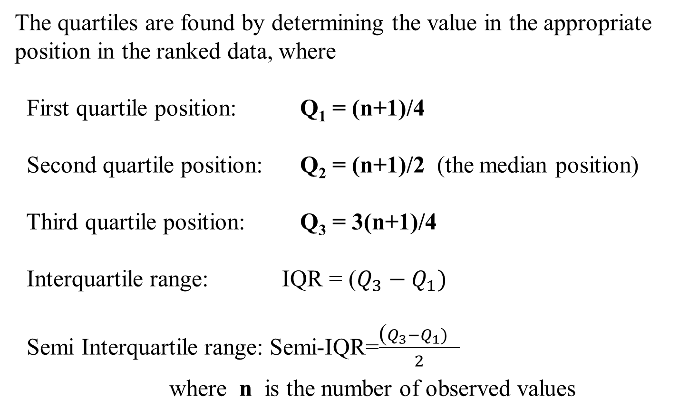
The Quartiles
The quartiles are found by determining the value in the appropriate position in the ranked data, where
First quartile position: Q₁ = (n+1)/4
Second quartile position: Q₂ = (n+1)/2 (the median position)
Third quartile position: Q₃ = 3(n+1)/4
Interquartile range: IQR = ($Q_{3}−Q_{1})$
Semi Interquartile range: Semi-IQR=$\frac{\text{(}Q_{3}−Q_{1}) }{2}$
where n is the number of observed values

Slide 40
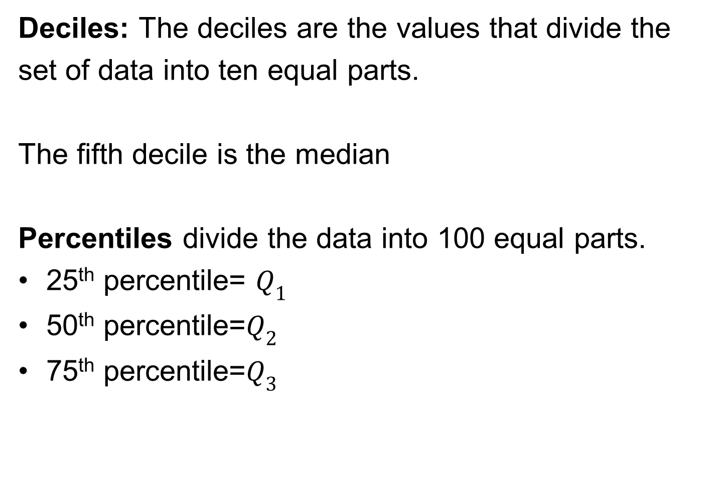
The Deciles and Percentiles
Deciles: The deciles are the values that divide the
set of data into ten equal parts.
The fifth decile is the median
Percentiles divide the data into 100 equal parts.
25th percentile= $Q_{1}$
50th percentile=$Q_{2}$
75th percentile=$Q_{3}$

Slide 41
The Quartiles: Example
Find the first quartile
Sample Data in Ordered Array: 11 12 13 16 16 17 18 21 22
(n = 9)
Q₁ is in the (9+1)/4 = 2.5 position of the ranked data
so use the value half way between the 2nd and 3rd values,
so Q₁ = 12.5
Q₁ and Q₃ are measures of noncentral location
Q₂ = median, a measure of central tendency

Slide 42
The Quartiles: Example
Find the other quartiles
Sample Data in Ordered Array: 11 12 13 16 16 17 18 21 22
(n = 9)
Q₁ is in the (9+1)/4 = 2.5 position of the ranked data,
so Q₁ = 12.5
Q₂ is in the (9+1)/2 = 5th position of the ranked data,
so Q₂ = median = 16
Q₃ is in the 3(9+1)/4 = 7.5 position of the ranked data,
so Q₃ = 19.5
IQR= 19.5-12.5=7 semi-IQR=7/2=3.5

Slide 43

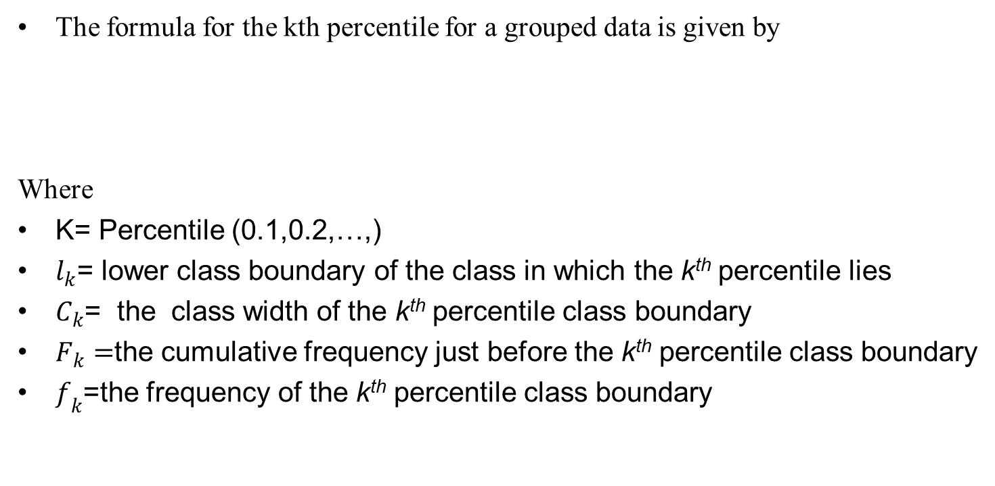
Measures of position for group data
Measures of position for grouped data can be determined by:
Interpolation method
The formula for the kth percentile for a grouped data is given by
Where
K= Percentile (0.1,0.2,…,)
$l_{k}$= lower class boundary of the class in which the k^{th} percentile lies
$C_{k}$= the class width of the k^{th} percentile class boundary
$F_{k}=$the cumulative frequency just before the k^{th} percentile class boundary
$f_{k}$=the frequency of the k^{th} percentile class boundary

Slide 44
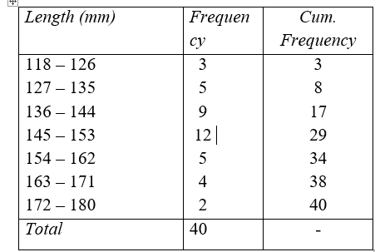
Measures of position for group data
Example
Find the 10th, 45th and 90th percentile of the data

Slide 45
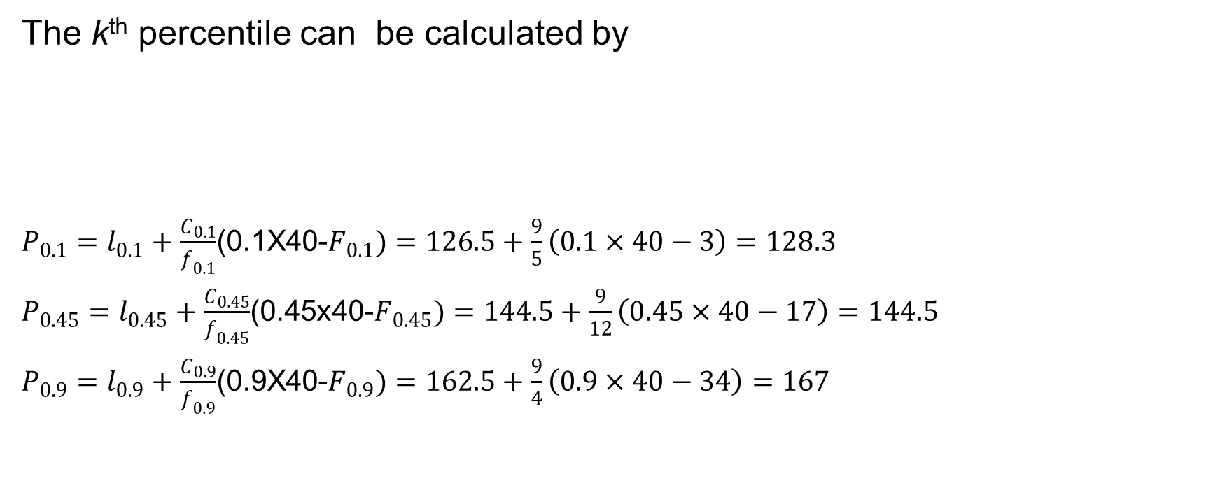
Measures of position for group data
Solution
The k^{th} percentile can be calculated by
$P_{0.1}=l_{0.1}+\frac{C_{0.1}}{f_{0.1}}$(0.1X40-$F_{0.1})=126.5+\frac{9}{5}\left(0.1×40−3\right)=128.3$
$P_{0.45}=l_{0.45}+\frac{C_{0.45}}{f_{0.45}}$(0.45x40-$F_{0.45})=144.5+\frac{9}{12}\left(0.45×40−17\right)=144.5$
$P_{0.9}=l_{0.9}+\frac{C_{0.9}}{f_{0.9}}$(0.9X40-$F_{0.9})=162.5+\frac{9}{4}\left(0.9×40−34\right)=167$

Slide 46
The Measure of Shape

Slide 47
The Measure of Shape
Measures of shape determine whether the distribution of data
exhibits a symmetric pattern or stretch out in a particular direction.
Two of such measures of shape are the
Skewness
Kurtosis/Peakness

Slide 48
Skewness
The skewness describe the degree of symmetry or asymmetry of a distribution.
Symmetrical distribution
Positively Skewed distribution
Negatively Skewed distribution
Coefficient of skewness:

Slide 49
Skewness
3- 48
Symmetric distribution: A distribution having the same shape on either side of the center
Skewed distribution: One whose shapes on either side of the center differ; a nonsymmetrical distribution.
Can be negatively or positively skewed

Slide 50
The Relative Positions of the Mean, Median, and Mode: Symmetric Distribution
Skewness
3- 49
Zero skewness Mean
=Median
=Mode

Slide 51
The Relative Positions of the Mean, Median, and Mode: Left Skewed Distribution
Skewness
3- 50
Negatively Skewed: Mean and Median are to the left of the Mode.
Mean<Median<Mode

Slide 52
The Relative Positions of the Mean, Median, and Mode: Right Skewed Distribution
Skewness
3- 51
Positively skewed: Mean and median are to the right of the mode.
Mean>Median>Mode

Slide 53

Example
Skewness
3- 52
The lengths of stay on the cancer floor of a hospital were organised into a frequency distribution. The mean length of stay was 28 days, the median, 25 days and mode, 23 days. The standard deviation was computed to be 4.2 days. Compute the skewness.

Slide 54

Kurtosis/Peakness
3- 53
The degree of peakness or kurtosis of a distribution is described
by the coefficient of kurtosis
If k=3 the distribution is said to be symmetrical or normal
If k<3 The distribution flattens at the centre than the normal distribution
If k>3 the distribution is more peaked than the normal distribution

Slide 55
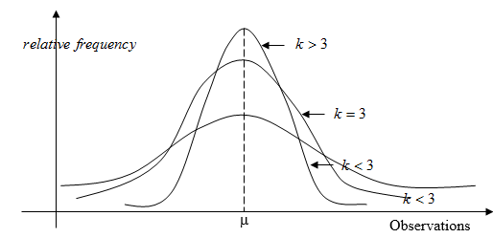
Graphs of Distributions indicating their Peakness
Kurtosis/Peakness
3- 54

Slide 56
Example
Kurtosis/Peakness
3- 55
The lengths of stay on the cancer floor of a hospital were organised into a frequency distribution. The mean length of stay was 28 days, the median, 25 days and mode, 23 days. The standard deviation was computed to be 4.2 days. Compute the skewness.

Slide 57
Assignment
3- 56
The data below show the age distribution of cases of malaria reported during year at a hospital.
34 17 25 37 19 19 27 19 44 24 24 22 32 12 13 16 18 14 12 16 14 17 10 16 22 20 15 15 10 10 14 17 20 18 13 32 13 13 18 30 24 34 44 31 43 40 28 31 15 22 15 31 18 27 35 35 20 32 38 32
(i) Organize the data into a frequency distribution table.
(ii) Calculate the coefficient of skewness and kurtosis and interpret your results.

Slide 58
Interpretation and uses of Standard Deviation
3- 57
Empirical Rule: For any symmetrical, bell-shaped distribution:
About 68% of the observations will lie within 1s the mean
About 95% of the observations will lie within 2s of the mean
Virtually all the observations will be within 3s of the mean

Slide 59
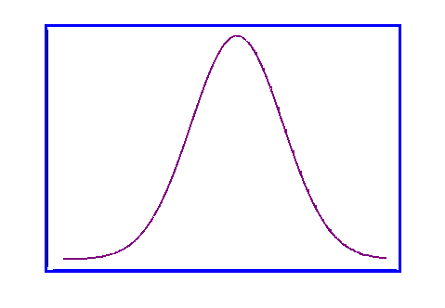
Interpretation and uses of Standard Deviation
68%
95%
99.7%
μ−3σ
μ−2σ
μ−1σ
μ
μ+1σ
μ+2σ
μ+ 3σ

Slide 60
Assignment
The data represent the recorded high temperature from a sensor for 50 districts in Ghana.
112, 100, 127, 120, 134, 118, 105, 110, 109, 112,
110, 118, 117, 116, 118, 112, 114, 114, 105, 109,
107, 112, 114, 115, 118, 117, 118, 122, 106, 110,
116, 108, 110, 121, 113, 120, 119, 111, 104, 111,
120, 113, 120, 117, 105, 110, 118, 112, 114, 114.
Calculate the coefficient of skewness for the data and sketch shape of its distribution

Slide 61
Exploratory Data Analysis (EDA)
Box-and-Whisker Plot:
A Graphical display of data using 5-number summary:
Minimum -- Q1 -- Median -- Q3 -- Maximum
Example:
25% 25% 25% 25%

Slide 62
Box-and-whisker plot
The Box and central line are centered between the endpoints if data are symmetric around the median
A Box-and-Whisker plot can be shown in either vertical or horizontal format
Min Q₁ Median Q₃ Max

Slide 63
Box-and-whisker plot: Example
Below is a Box-and-Whisker plot for the following data: 0 2 2 2 3 3 4 5 5 10 27
The data are right skewed, as the plot depicts
Min Q1 Q2 Q3 Max
0 2 3 5 27

Slide 64
Distribution Shape and Box-and-whisker plot
Left-Skewed
Symmetric
Right-Skewed
Q1
Q2
Q3
Q1
Q2
Q3
Q1
Q2
Q3

